Slide 1
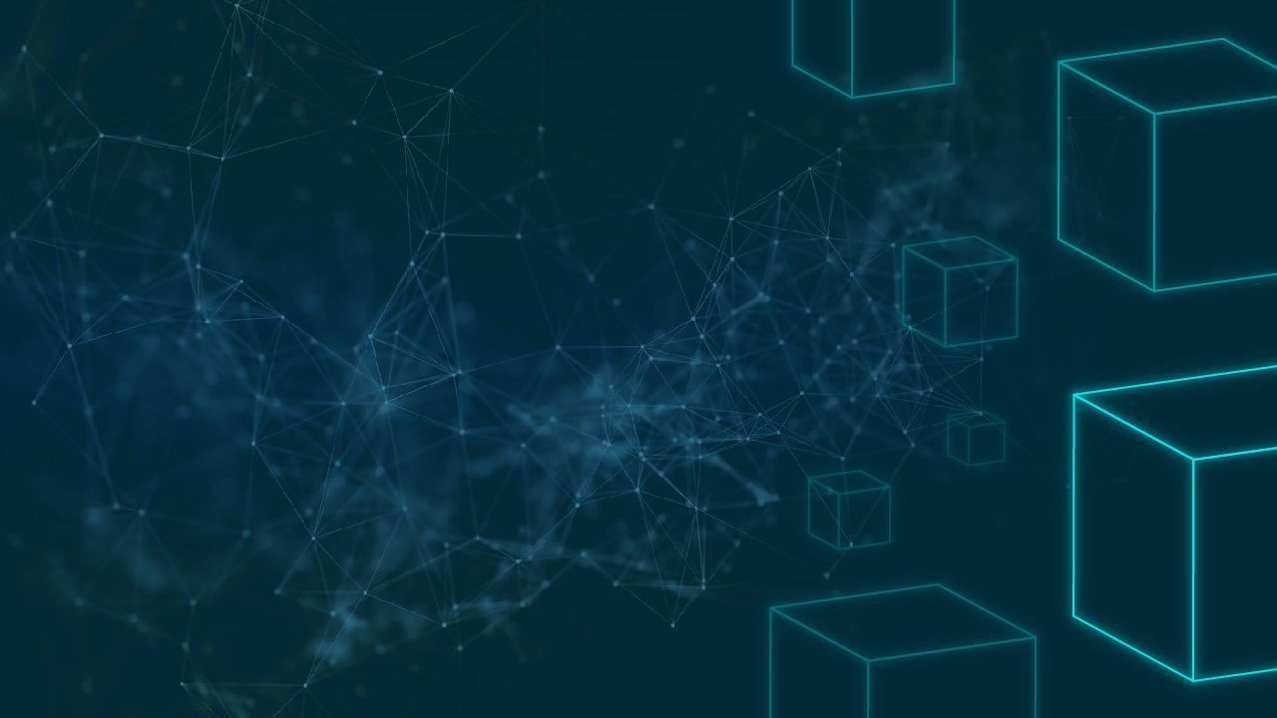

Blood Donor App
Juan Emmanuel Dharmadjaya – Batch 5

Slide 2

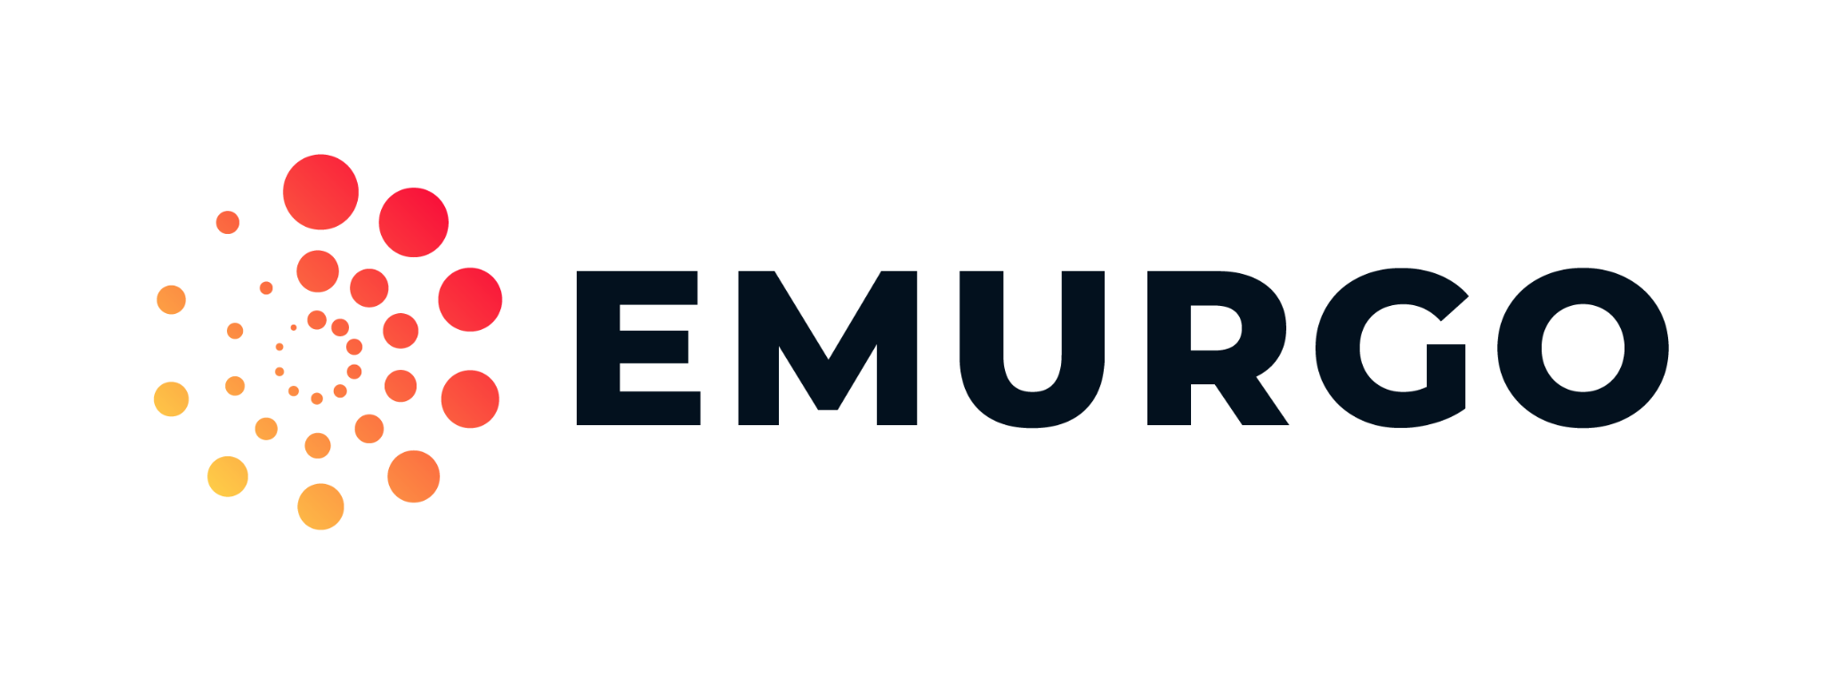
Executive Summary
A blood donation app would be an excellent introduction as a blockchain-based app that would benefit the traceability, integrity, and availability of the blood bag.

Slide 3
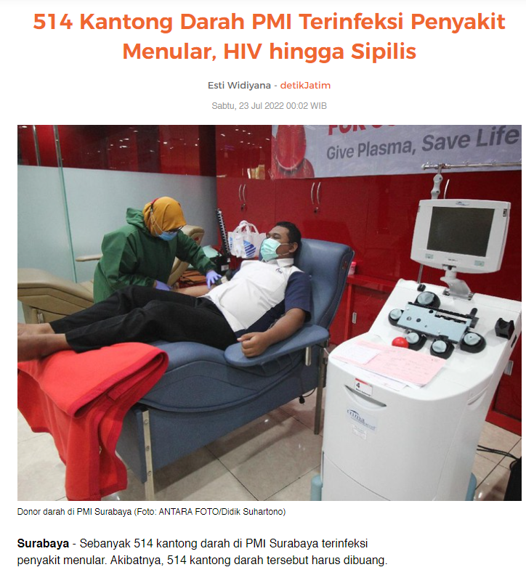
Current Problem
Current problem:
Traditional data will be stored with the risk of losing or being modified
The criminals or associates would be harder to track if they have modified a data
Verification conducted by centralized system is vulnerable by the insider job
Risks of getting infected blood-bag

Slide 4
Proposed Solution
A blood donation application with the purpose to maintain the traceability, integrity, and availability of the blood

Slide 5
Actors Involved
Blood Donor
Do the donation
Institution
Collects the blood
Verify the blood
Store the blood information

Slide 6
Expected Outcome
Since the storing process will be private decentralized then it is expected that the evidence integrity and availability is still intact and if there is a misconduct or criminal activities involved then it is traceable.

Slide 7
Why Using Blockchain
(How Blockchain Can Help to Solving The Problem)
Blockchain contained immutable data. This data can be customized using smart contracts in which can be implement to the blood donation systems. The consensus and immutable respect the data integrity nature. The data will also be traceable since any changes inside the blocks will be detected and saved.

Slide 8
Features
Login & Register
Store blood data to txt
Validate blood
Show collections of blood

Slide 9
Things to consider for healthy blood
Age of 18-65
Minimum of 50 KG weight
No tattoos
Not doing a surgery soon
No alcohol and caffeine

Slide 10
Things to consider for healthy blood
Normal Hemoglobin Level
No HIV/AIDS
No Hepatitis
No Syphilis
No Malaria

Slide 11
DEMO

Slide 12
Thank You

